Slide 1
Ladybird Health
An Application for the Uninsured of Austin, Texas
Team Ladybird
Amanda Gomez, Cecilia King, Hayley Allmand, Kurtis Raucstadt, Tanvi Varadhachary, Taylor Zheng
Austin Cloud Engineers
July 6th, 2020

Slide 2
Safe harbor statement
The following is intended to outline our general product direction. It is intended for information purposes only, and may not be incorporated into any contract. It is not a commitment to deliver any material, code, or functionality, and should not be relied upon in making purchasing decisions.
The development, release, timing, and pricing of any features or functionality described for Oracle’s products may change and remains at the sole discretion of Oracle Corporation.

Slide 3
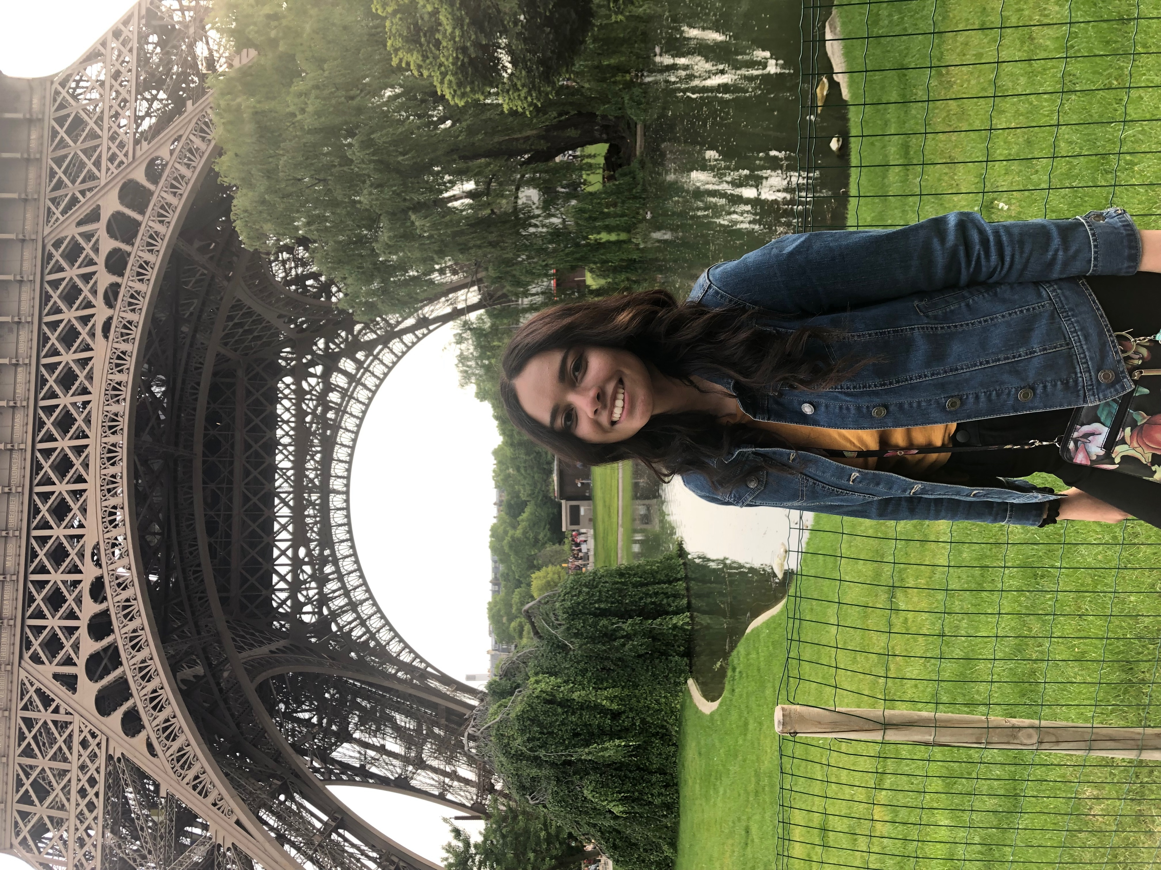
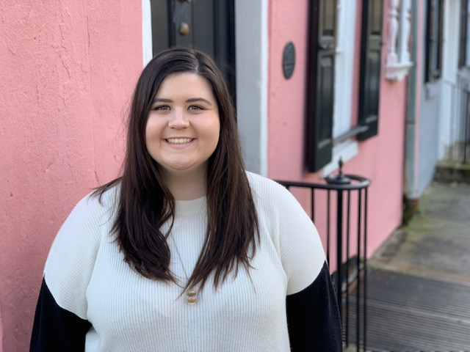
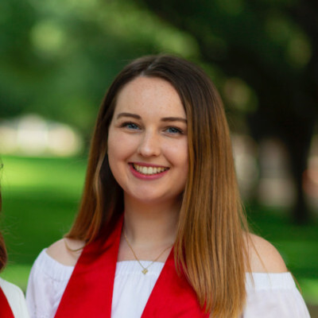
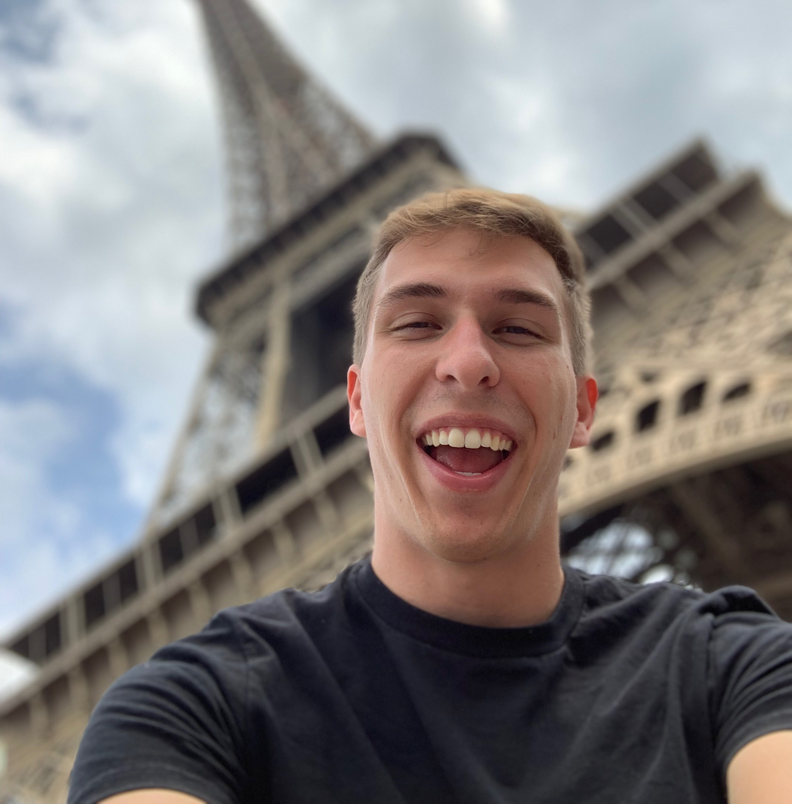
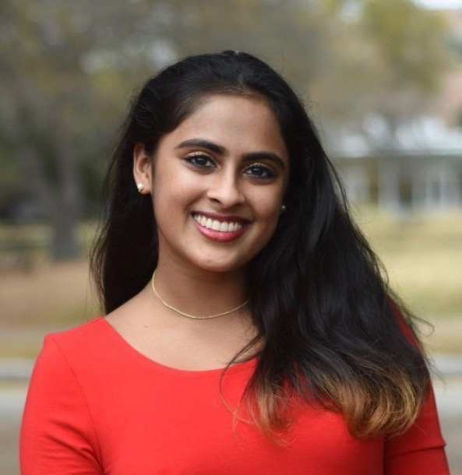
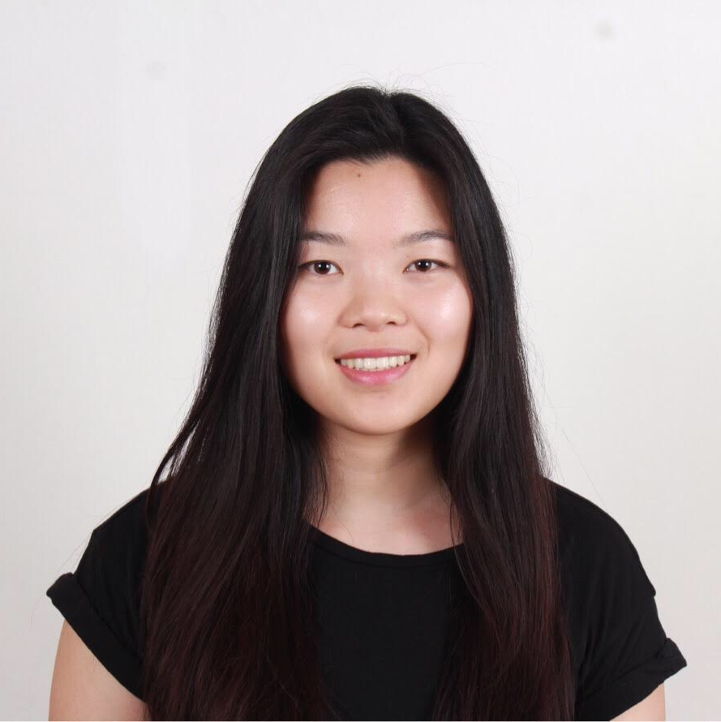
Our Team
Amanda Gomez
Mid-Market
Cecilia King
Enterprise
Hayley Allmand
Enterprise
Kurtis Raucstadt
SMB
Tanvi Varadhachary
Enterprise
Taylor Zheng
SMB

Slide 4
What would you do if you didn’t have access to insurance?

Slide 5
Facts About the Uninsured in Texas
1
18% of Texas residents are uninsured (compared to 9% of US)
2
17% of Austin, Texas residents under age 65 are uninsured
3
1.6 Million Texans are undocumented
4
14% of undocumented immigrants in the US live in Texas
5
Major barriers to healthcare access include language and social barriers

Slide 6


3rd Party Translation APIs
User Friendly Development
ADW
Service Gateway
Object Storage
End User
Digital Assistant
3rd Party Location APIs
APEX
VCN
OCI
Web/Mobile Application
Oracle Cloud

Slide 7
Technical Walk Through

Slide 8
Front End Walk Through

Slide 9
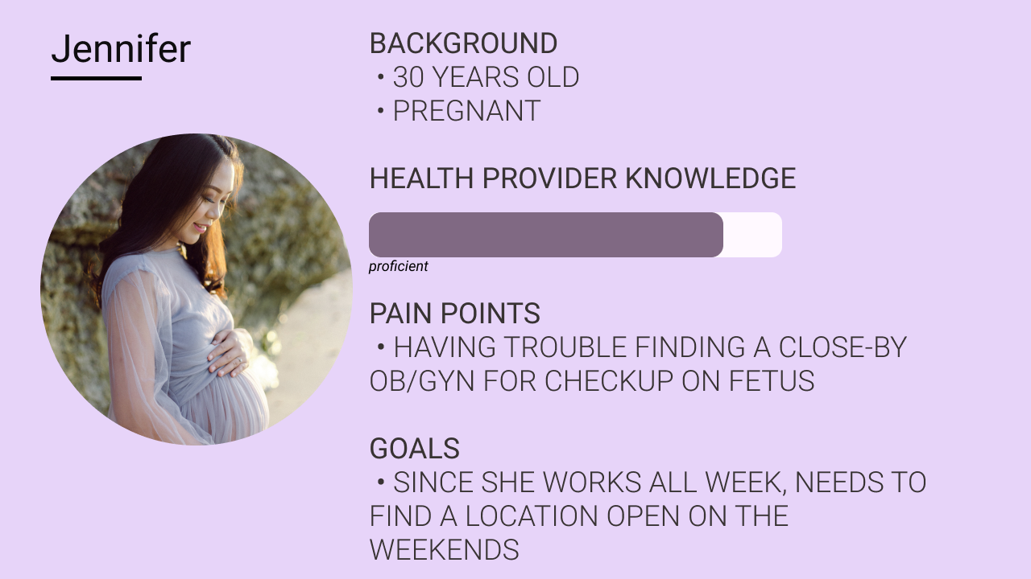

Slide 10
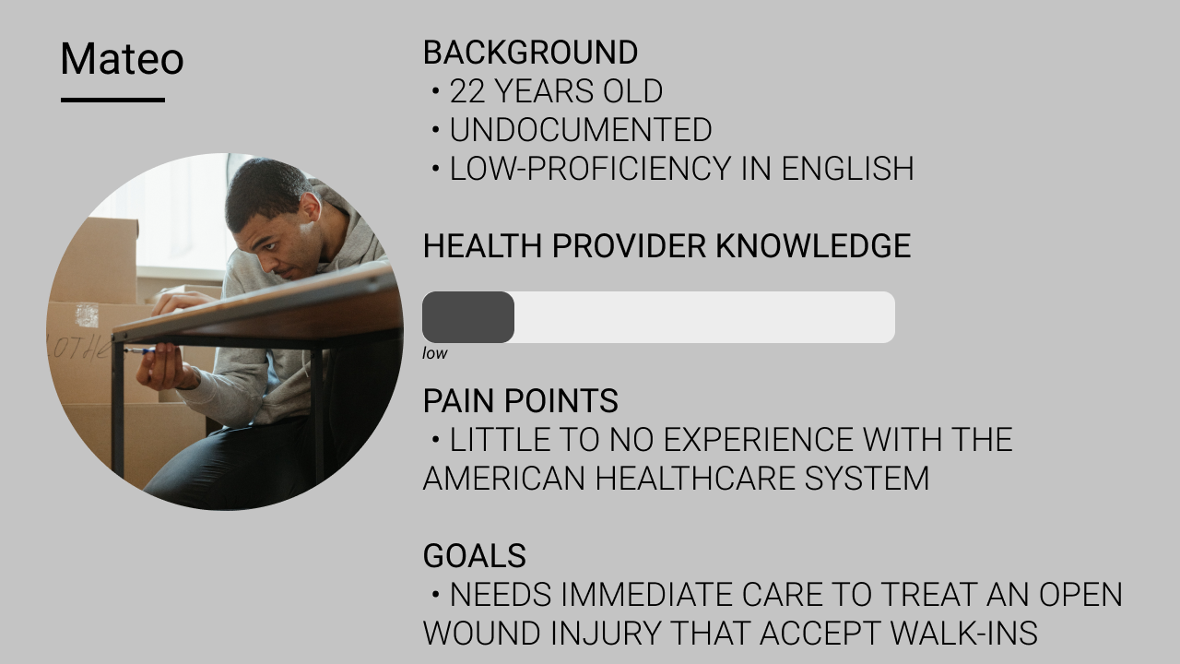
Personas

Slide 11
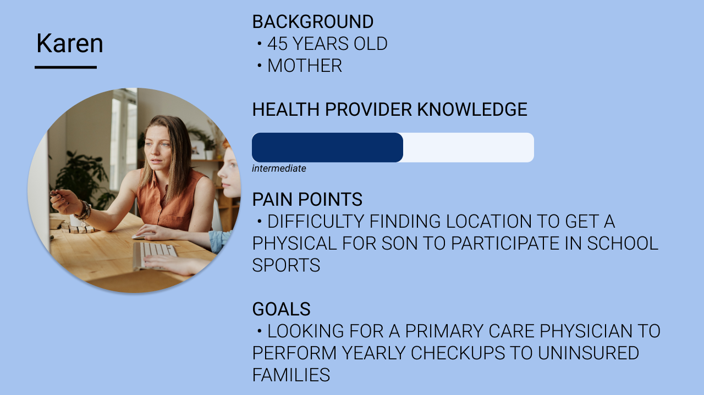
Personas

Slide 12
How might you expand upon your solution in the future?
Expand to include other healthcare facilities
Create a user specific experience including…
Log in page
Saved user data
Create a more accessible application both internally and externally

